Slide 1


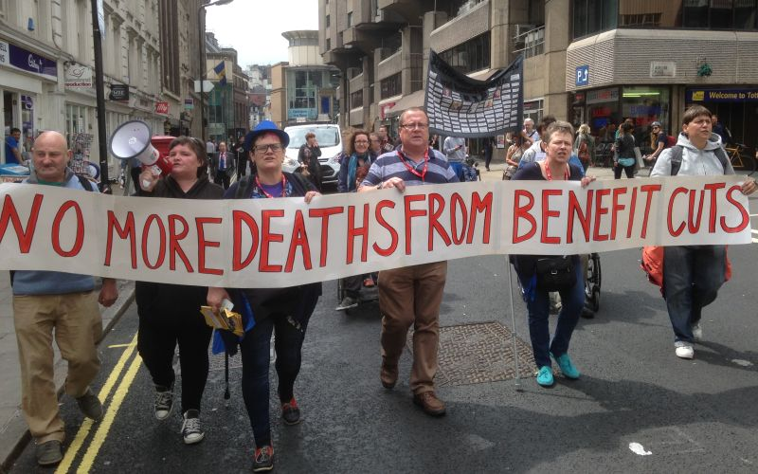
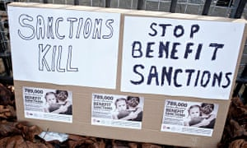
Social security austerity: structural violence & social murder
Chris Grover
Department of Sociology
Lancaster University

Slide 2
Today’s talk
Benefit cuts
Impacts of social security austerity
Social security austerity as structural violence
Social security austerity as social murder

Slide 3
Benefit cuts
Benefit for lone mother with three children:
2016 – £247 pw
2019 – £180 pw (one child born after April 2017)
2010 - £18 billion p.a. cuts to ‘social protection’ by 2014/15
2012 – further £4.5 billion p.a. by 2015
2015 – further £12 billion p.a. by 2020
Relative (below inflation) & absolute cuts (removals, restrictions & limits)
Increased conditionality: easier to lose benefits for longer periods for more people
Greatest impact upon: the poorest households (e.g. non-working lone mothers); households with three or more children; households with children under age of five; households with disabled people

Slide 4
Impact of benefit cuts
Death and other harms (for example):
Disabled people’s organisation: deaths and Employment and Support Allowance – e.g. Calum’s list (http://calumslist.org/); We are Spartacus (2015)
Remember the Dead (https://www.facebook.com/ribbonsforwelfare/)
Barr et al (2015) – for every 10,000 Work Capability Assessment
six additional suicides
2,700 reported case of ‘mental health problems’
7,000 anti-depressant items prescribed
McManus et al. (2016)
66.4% of Employment and Support Allowance recipients thought about killing themselves; 43.2% had attempted (compared to 21.7% and 6.7%)
Increasing number of deaths of homeless people
Coroners’ and inquest reports highlight austerity as elements in deaths
Emotionality of austerity: fears, anxiety, stress

Slide 5
Austerity as structural violence
Galtung (1969)
violence as ‘difference between the potential and the actual’ (p. 168, original italics)
violence as acts where detrimental impacts are known and avoidable
detrimental impacts of poverty and austerity known for many years
austerity and poverty – political choices; not inevitable (therefore are avoidable)
structural violence: ‘built into the structure and shows up in unequal power and consequently as unequal life chances’ (p. 171):
austerity is producing unequal life chances:
increasing poverty
falling living standards
precarious waged-work
disabilised, gendered and racialised inequality
increasing rough sleeping

Slide 6
Understanding austerity as social murder
Social murder
Friedrich Engels – economic conditions and the killing and maiming of working class people
‘...when society... deprives thousands of the necessities of life, places them under conditions in which they cannot live... knows that... thousands of victims must perish, and yet permits these conditions to remain, its deed is murder just as surely as the deed of the single individual’ (Engels, 1993: 106, originally 1845)
More recent focus upon the state and social murder:
state allows corporations to kill consumers (Chernomas and Hudson, 2007, 2009)
ideological objection to regulation; local authority budgets cuts; privatisation results in social murder (Tombs, 2017)

Slide 7
Understanding austerity as social murder
Austerity as social murder:
again, impacts that are known and avoidable
intention of austerity to kill/maim/harm income poor people?
‘dead people don’t claim’ (Mills, 2018)
live people do consume; provide others with work; have macro-economic impacts
Engels (1993, p. 106): social murder is an ‘offence… more… of omission than commission’
consequence of ‘reckless and wanton disregard for the lives of those affected’ (Rummel, 1994: 42)

Slide 8
Conclusions
Social security austerity disproportionately impacts the income poorest people
can be understood as a form of structural violence
harms that are known and avoidable
reproduction of unequal life chances
can be understood as social murder
the harming of poor people through their impoverishment
affective dimensions of austerity – anxiety, fear and stress

