Slide 1
‘Social Death - the impact of austerity and poverty’
Beyond reasonable doubt: the deaths and the blame
Danny Dorling, May 1st 2019
Taxpayers Against Poverty Seminar Portcullis house, Westminster.
In some areas of the country life expectancy began to fall. It then fell for all the poorest of infants born in the country. However, whenever any suggestion was made that central government austerity and health policies might had an adverse impact on the health of the nations of the UK, these suggestions were always (and without exception) dismissed out-of-hand by the department of health media representatives as being preposterous suggestions. In this talk the story is told, some of the evidence presented and the question raised as to who in government did not know. Who might have known and did not care. And who knew, cared, but thought all this was a price worth paying for what they really wanted to happen to health and other public services. To privatise a service first you have to run it down.
In the eight years since the May 2010 general election, the health of people living in the United Kingdom has faltered. At first the only evidence came from surveys in which people started to say in greater numbers that their health was getting worse. Then they started dying a little earlier than before, and then a lot earlier. By early 2018 we were seeing slowdowns in health improvements not experienced since at least the 1890s.

Slide 2
On 10 December 2012 the following email was sent by an operator at the private health care firm Harmoni to the freelance doctors on its books, pleading for at least one of them to cover the early night shift for the Whittington area from 7.30 that evening until 1 o’clock the following morning:
Sent 10.12.2012 09.36 hrs
URGENT COVER NEEDED TONIGHT
Dear All URGENT COVER NEEDED FOR TONIGHT:
Whittington PCC 19.30-23.30
Visiting Session 19.00-01.00
Overnight Face to Face 00.00-08.00
Please contact XXXXXXXXXX if you are available to help *Rates can be discussed

Slide 3
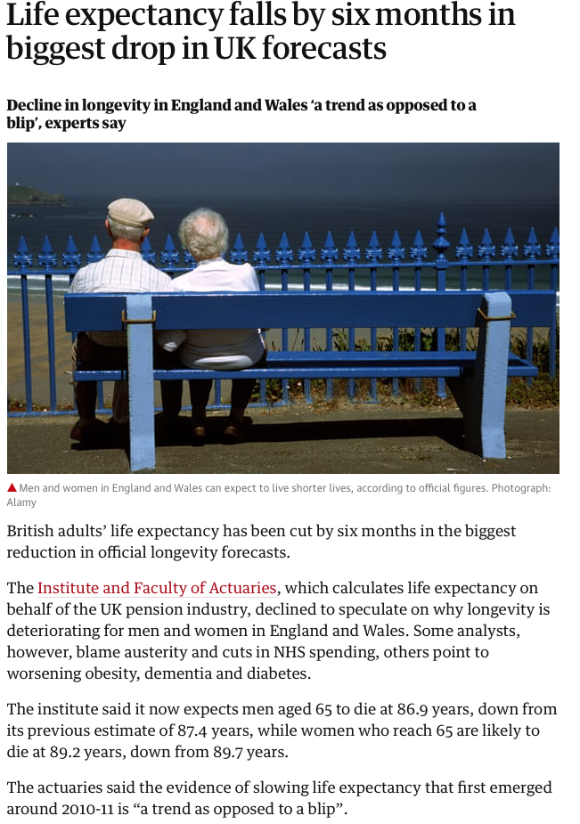
Austerity and the cuts appear to not just have effected the poorest areas. Places where many people live into their eighties have also been badly effected. In March 2019 we learnt that the trend that started in 2010-2011 has worsened. The total fall in life expectancy compared to 2015 projections is 13 months for men and 14 months for women, for people aged 65 across all of the UK. The welfare state is used more in old age by people who were middle class in middle age because they tend to live longer.
Patrick Collinson, The Guardian, March 7th 2019:
https://www.theguardian.com/society/2019/mar/07/life-expectancy-slumps-by-five-months

Slide 4
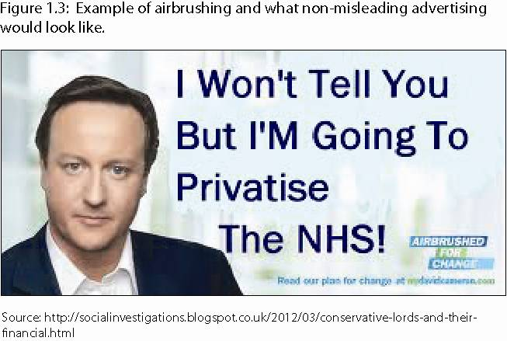
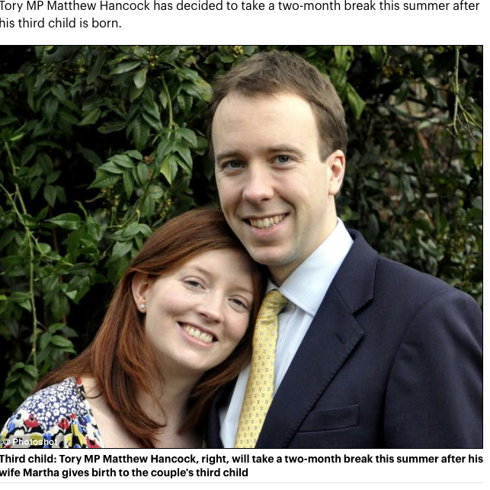
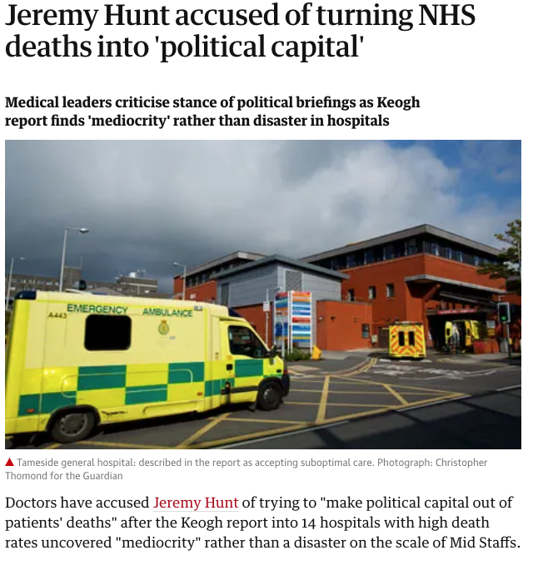
https://www.dailymail.co.uk/news/article-2331396/Im-taking-months-paternity-leave-boasts-Tory-business-minister.html

Slide 5
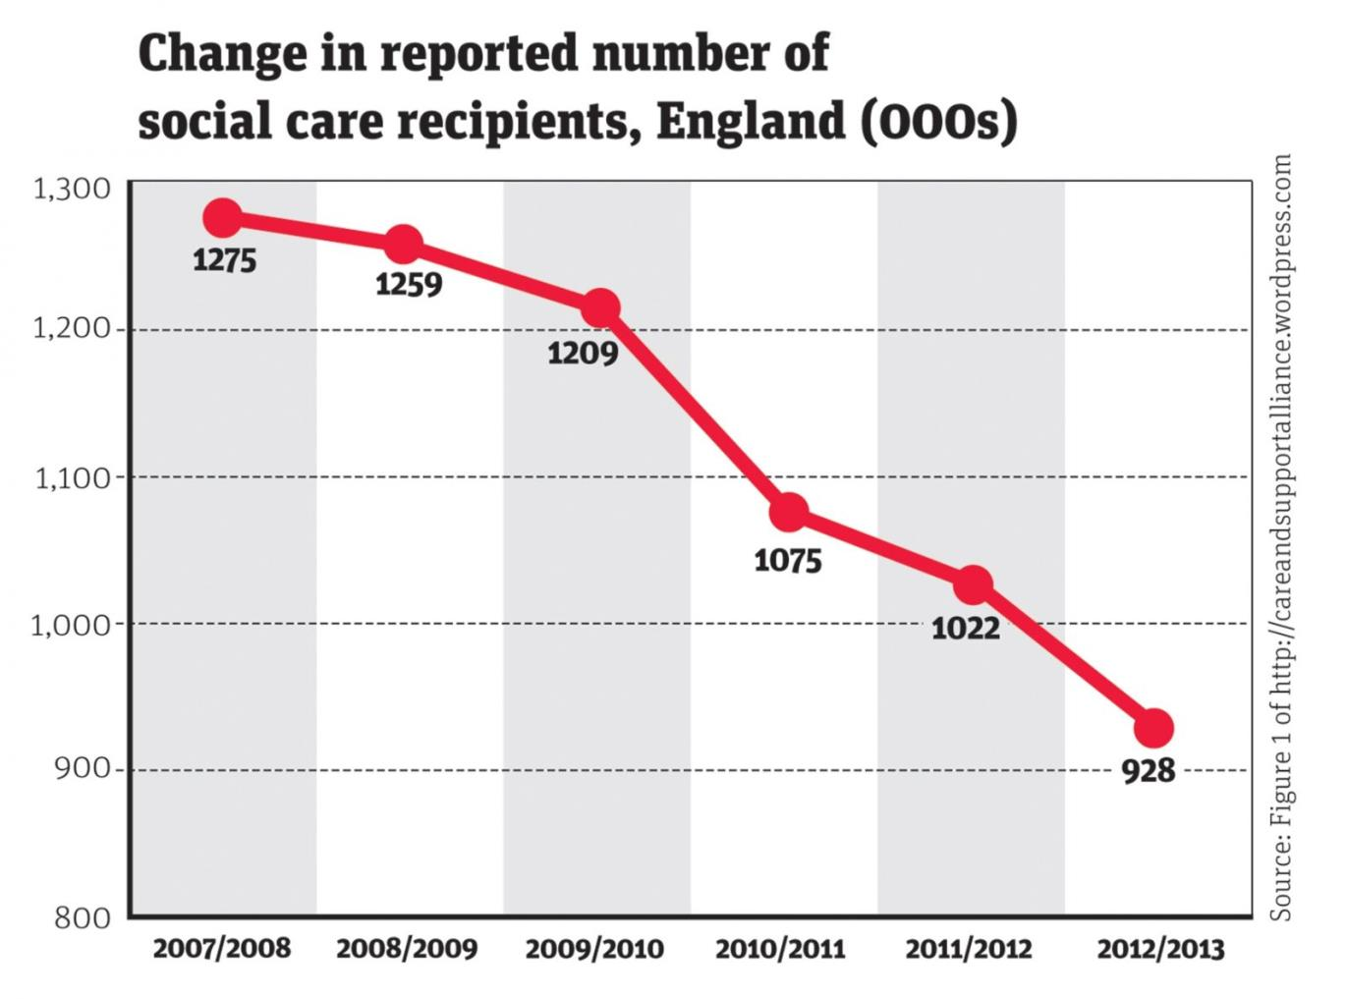
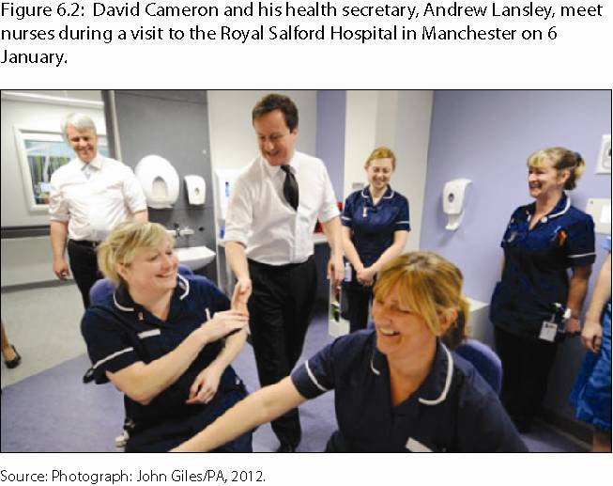
Between 2008 and 2013, cuts led to some 483,000 old and disabled people in the UK either losing their care support or becoming no longer eligible to claim it. “reductions … are particularly acute for older people”. There are now millions fewer social care visits a year to the elderly than took place five years ago. The biggest cuts to visits came after the general election of May 2010.

Slide 6
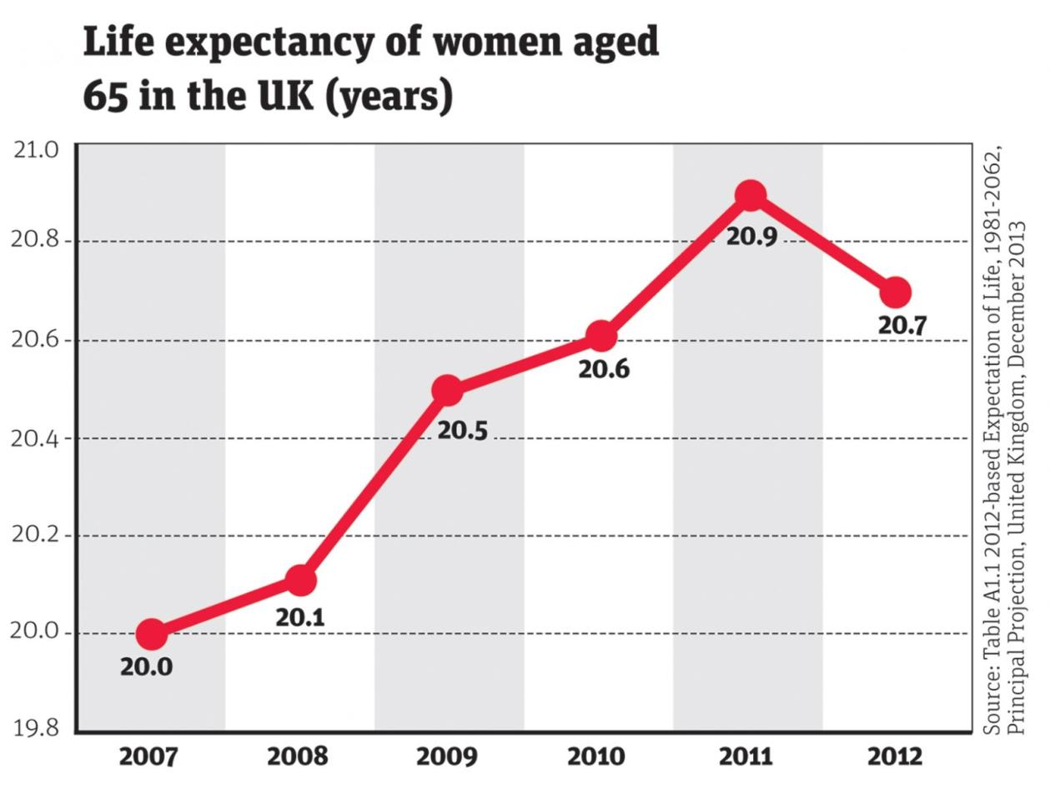
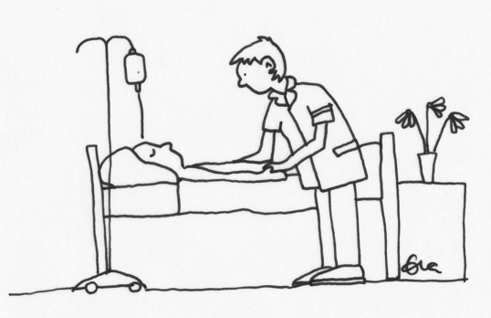
In the year to June 2013, some 23 400 more deaths than expected occurred (5% more).
Post retirement life expectancy dropped by 2%.
Influenza and pneumonia can have contributed only 5.8% and 3.5% (unless there was mass misdiagnosis).

Slide 7
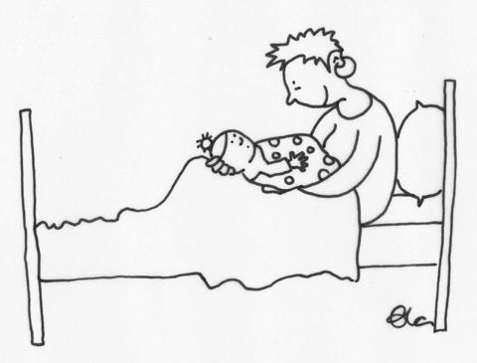
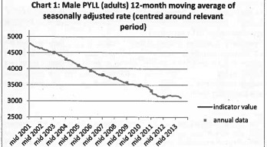
Peaks tend to be multi-causal
July 2011: UK’s largest private care home provider about to go bankrupt and might need to close all 752 homes – no effect? …Women deaths rate rose much faster than men’s.
The BBC posted this story as a piece of ‘business
news’. The coalition did not intervene early on.
The underlying issue was landlords’ rents.

Slide 8
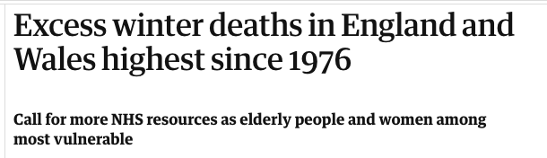
One cause blamed officially - flu
A traditional scapegoat - in just four months, from December 1952 to March 1953, some 12,000 residents perished in London above the number a year early. Housing Minister Harold Macmillan blamed the flu. It was smog.
“The 1953 smog matters today. It tells us what ministers and their officials are capable of.”
30th Nov 2018 story – and yet again blamed on flu.

Slide 9
NHS November 2013 (web) advice:
If you are 65 or over, it is important to spend most of your time in a warm environment during the winter months. There are a number of things you can do to cope in cold weather. Keep your main living room at around 18-21°C (65-70°F) and the rest of the house at least 16°C (61°F). If you can’t heat all the rooms you use, heat the living room during the day and the bedroom just before you go to sleep. Make sure you are receiving any benefits you are entitled to, such as the winter fuel payment and cold weather payment. Regular hot drinks and eating at least one hot meal a day will help keep energy levels up during winter and keep your body warm. Finally, make sure you get the seasonal flu jab.

Slide 10
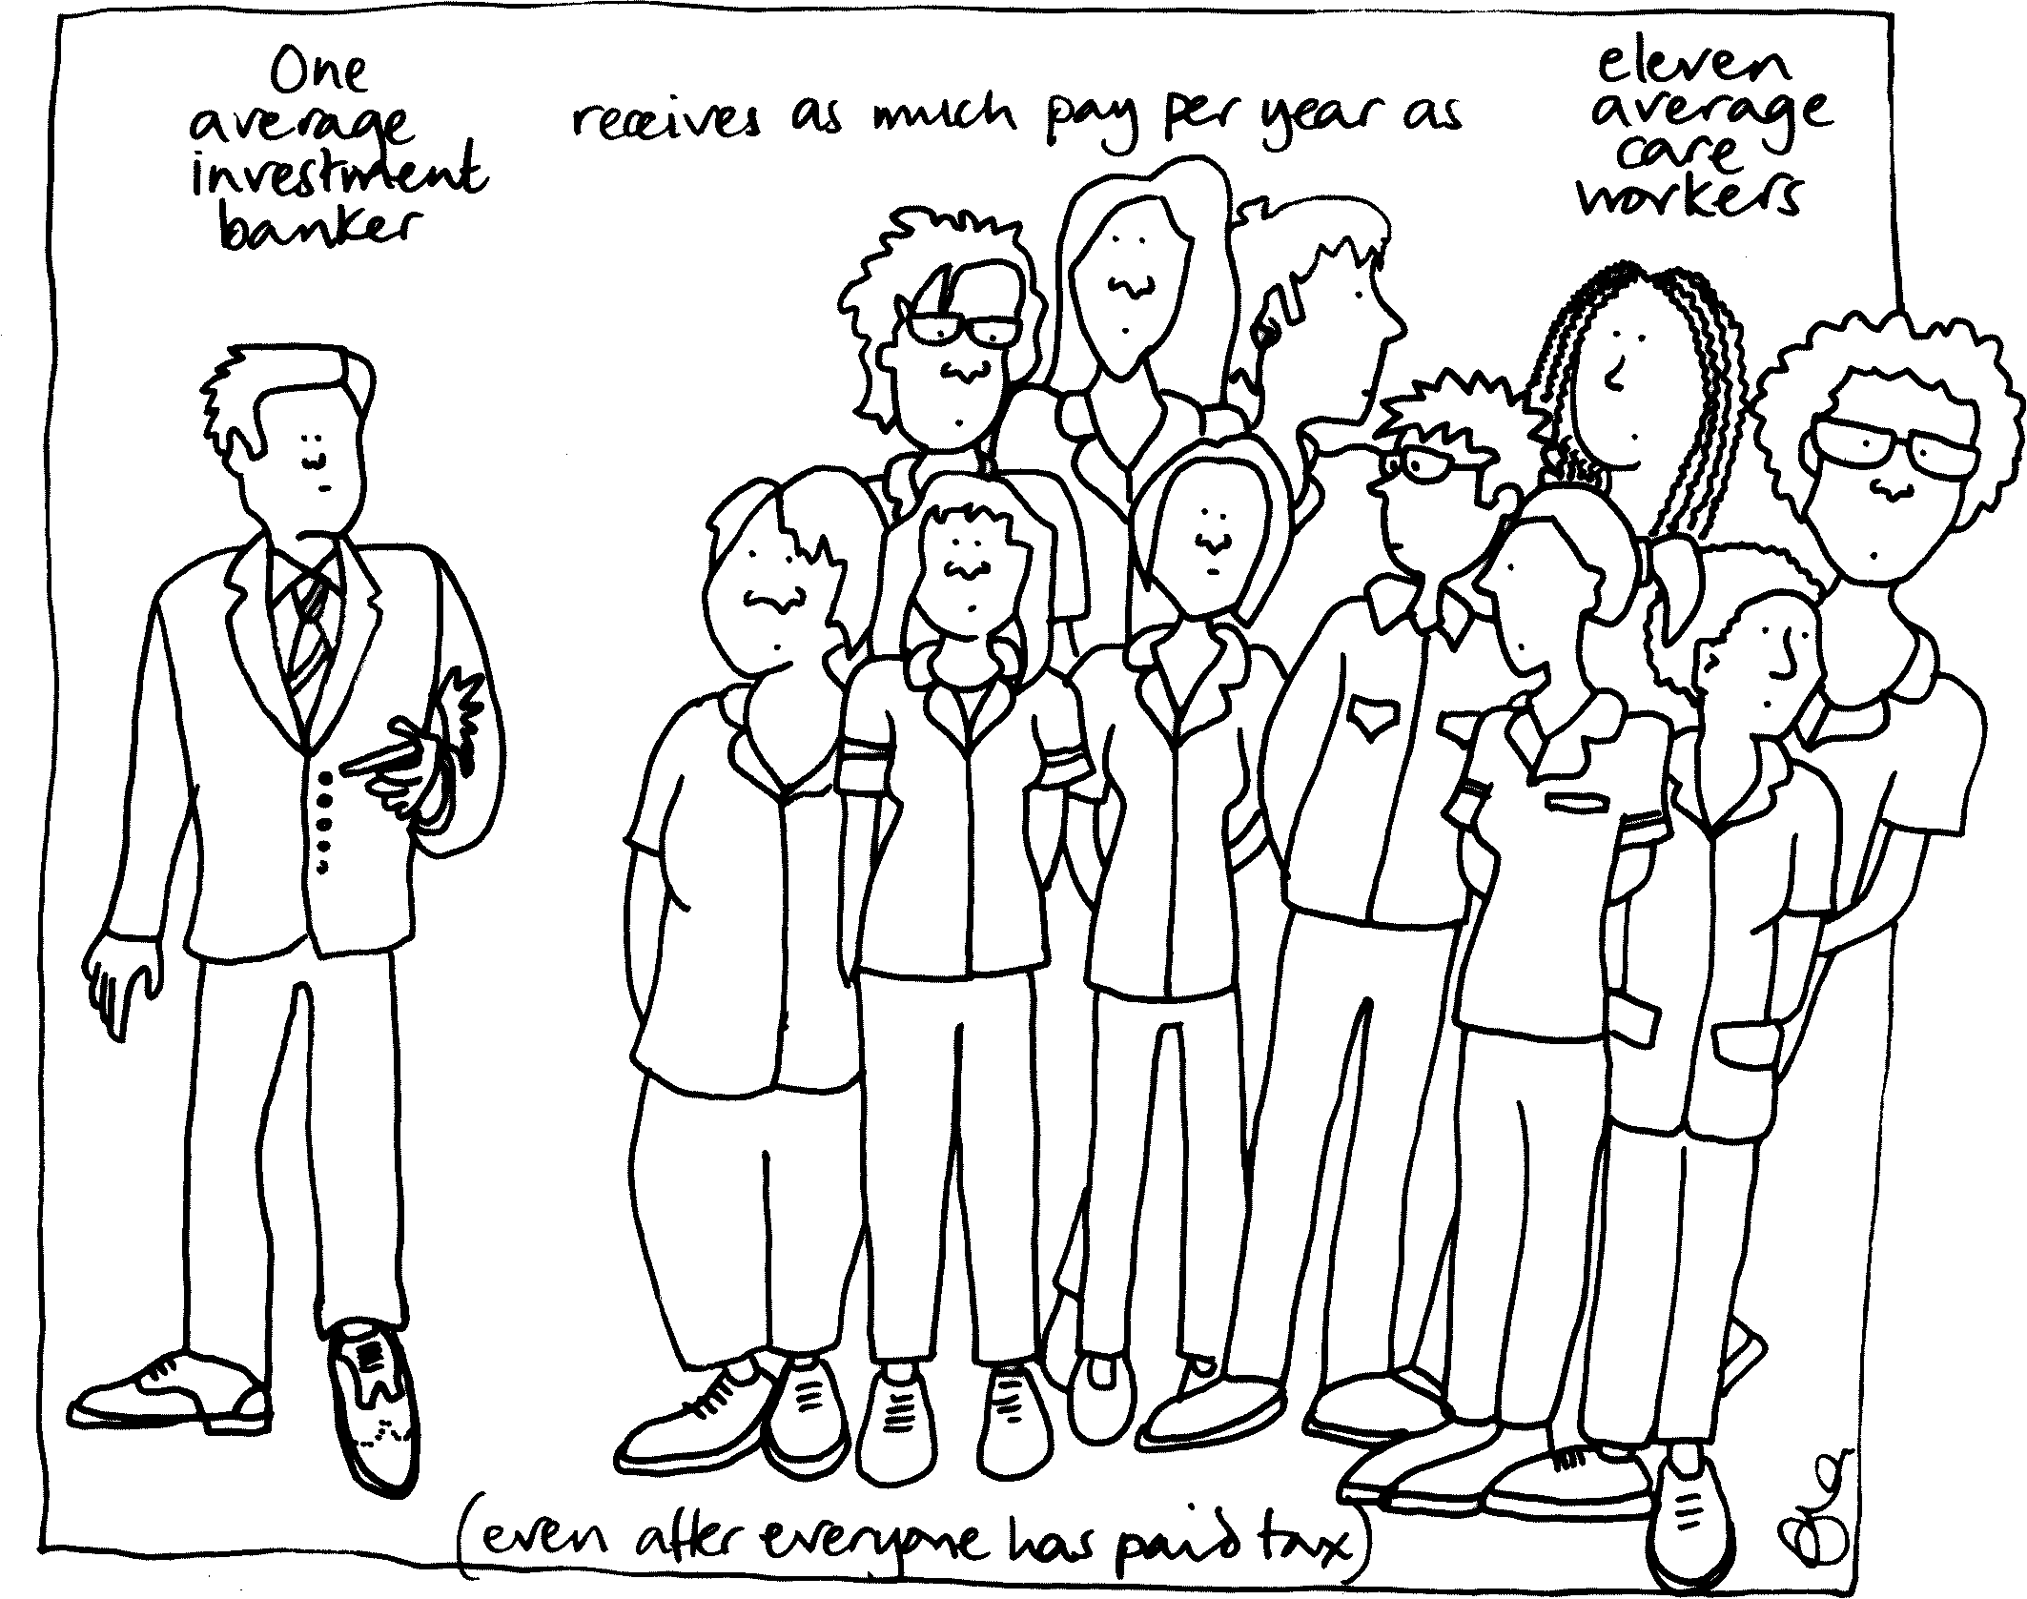
Hard not to conclude
It was almost certainly not flu (minimal). It may not even mostly have been the cold. The winter of 2009/2010 was colder than our recent winters, yet far fewer died then. It is hard to believe that it is not the rising callousness of our age which, in so many ways, is driving growing numbers of elderly people to die earlier than expected.

Slide 11
No wonder rates of mental illness are rising among the young

Slide 12
Including increases in the legal taking of mind altering drugs (now more than a tenth of the population)

Slide 13
The Vote Reflects a Health Crisis
On the day of the EU referendum data from the ONS revealed there had been 52,400 more deaths in the year to June 2015 as compared to the same period a year before.
Death rates in England and Wales rose overall by 9% and by 12% for those aged 90+; by 10% for those aged 85-89; 7% for those aged 80-84; 5% for those aged 75-70; and by 3% for those aged 55-74. These rate rises were unprecedented.
They were attributed to dementia and Alzheimer’s, with influenza being suggested as a contributory factor. Austerity played a major role. It was those with long term care needs who were dying earlier. The health and social services crises will worsen further as national finances worsen and as it becomes harder to recruit and retain staff from the European mainland (death rates only fell for adults aged 25-29).

Slide 14
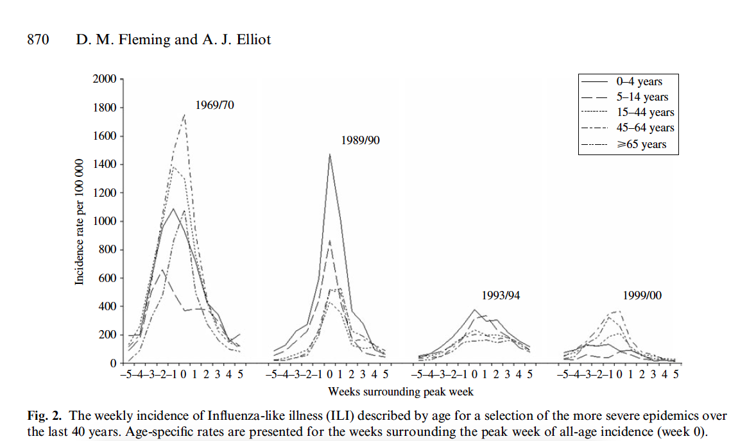
From a talk given in Bristol, October 2016
This is what a flu epidemic looks like when you have a severe epidemic in England and Wales

Slide 15
24% 1918 1. Influenza (pandemic)
16% 1940 2. War
15% 1929 3. Very Cold winter
13% 1895 4. The Great Frost
10% 1846 5. Cholera
9% 1849 6. Cholera
9% 2015 7. What? (7% rise calender year)
8% 1911
8% 1915
7% 1931
7% 1890
7% 1863
7% 1847
7% 1951
6% 1878
6% 1927
6% 1857
6% 1858
6% 1851 (Flu)
6% 1943
6% 1904
6% 1924
6% 1968 23. Flu
The largest single year rises in mortality in England and Wales 1840-2015 (relative increase in mortality rate on the year before
The rise in the overall death rate between the calendar years 2014 and 2015 was 7% - the last time a calendar year rise was a big as that was 1951 (When more people died of Flu in Liverpool than in the 1918 pandemic). Source of that claim: http://wwwnc.cdc.gov/eid/article/12/4/05-0695_article

Slide 16
Before the great rise in deaths we had some warnings – dismissed as artifact….

Slide 18
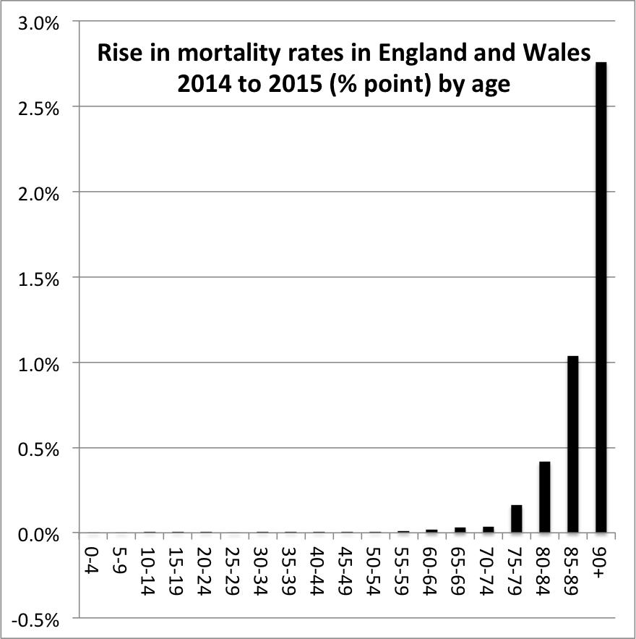
Largest absolute mortality rate
Rises (calendar year comparisons):
Trends in mortality rates by age: ONS mid year estimates for 2014 and 2015 (absolute)
1 1918 0.35%
2 1846 0.22%
3 1895 0.21%
4 1849 0.21%
5 1940 0.19%
6 1929 0.18%
7 1847 0.17%
8 1863 0.16%
9 1890 0.13%
10 1878 0.13%
11 1858 0.13%
12 1857 0.13%
13 1851 0.12%
14 1874 0.12%
15 1911 0.11%
16 1915 0.11%
17 1840 0.10%
18 1904 0.09%
19 1931 0.09%
20 1951 0.08%
21 1864 0.08%
22 1899 0.07%
23 1927 0.07%
24 1943 0.07%
25 1882 0.07%
26 1891 0.07%
27 1924 0.07%
28 1854 0.06%
29 1968 0.06%
30 1870 0.06%
31 1922 0.06%
32 2015 0.06%

Slide 19
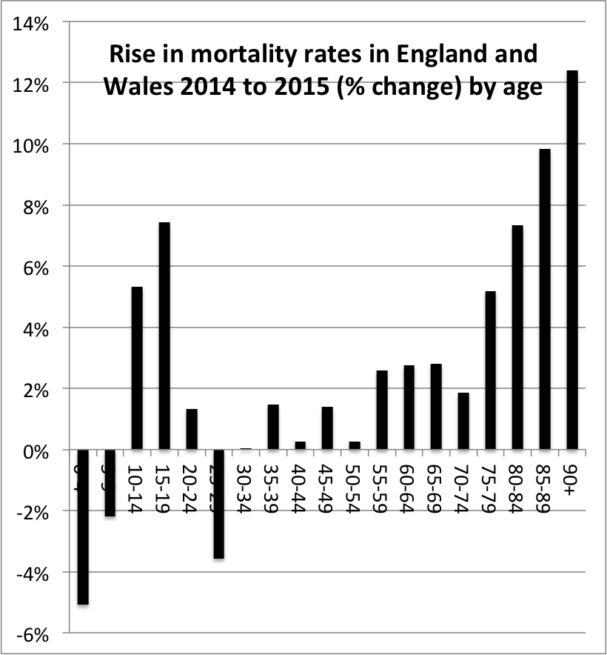
Trends in mortality rates by age: ONS mid year estimates for 2014 and 2015 (relative)

Slide 20
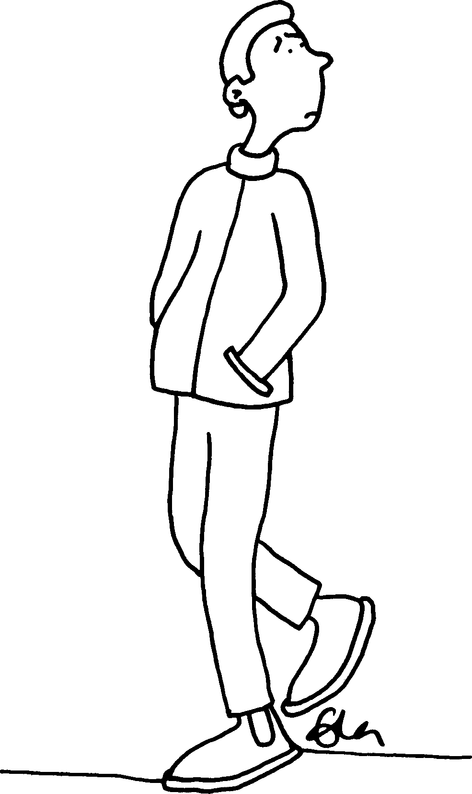
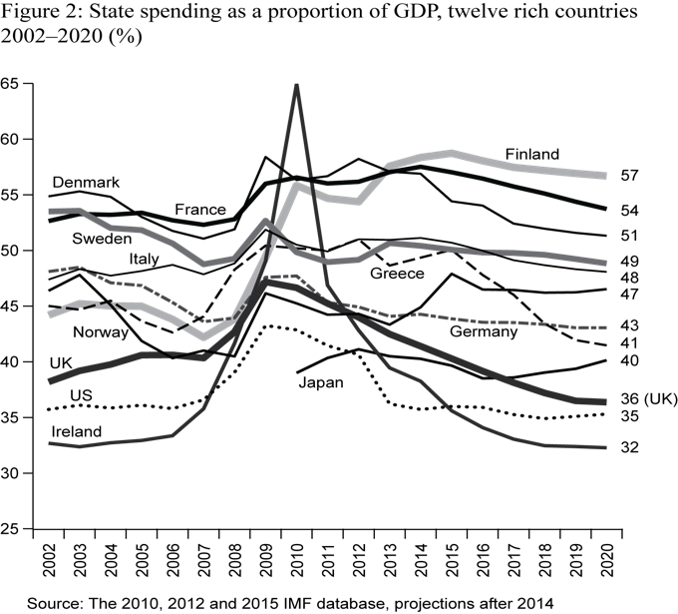

Slide 21
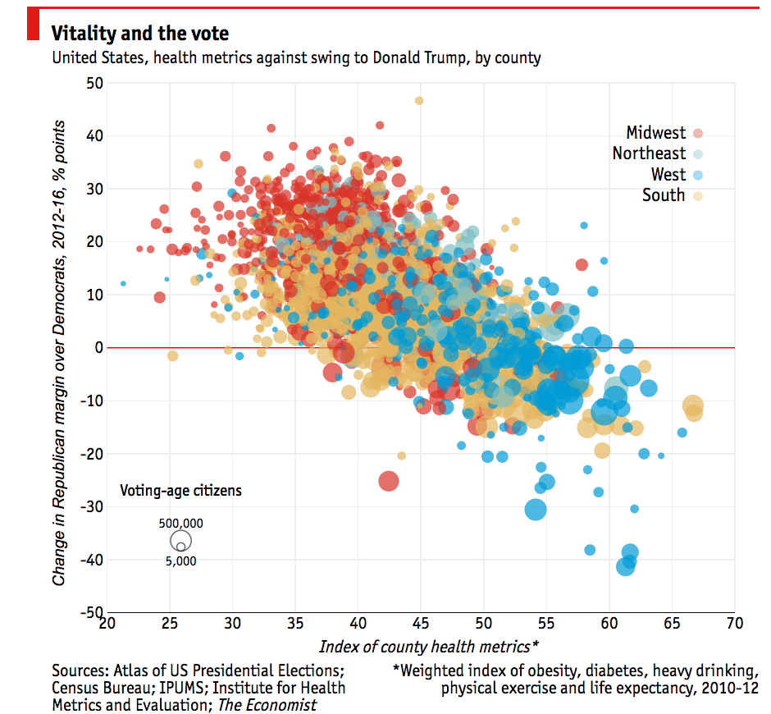
On November 19th the Economist
Magazine published the best correlates to “explain” why increase for the Republicans rose in some areas and not in others – poor health: “even after controlling for race, education, age, sex, income, marital status, immigration and employment, these figures remain highly statistically significant.”
http://www.economist.com/news/united-states/21710265-local-health-outcomes-predict-trumpward-swings-illness-indicator

Slide 22
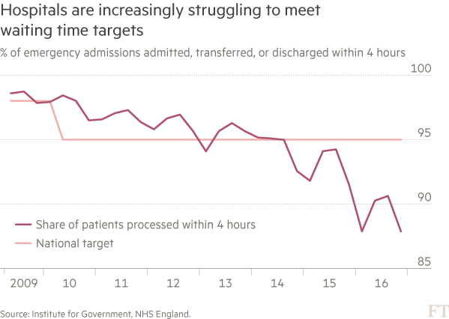
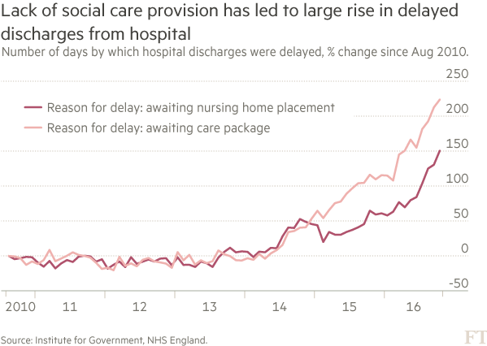
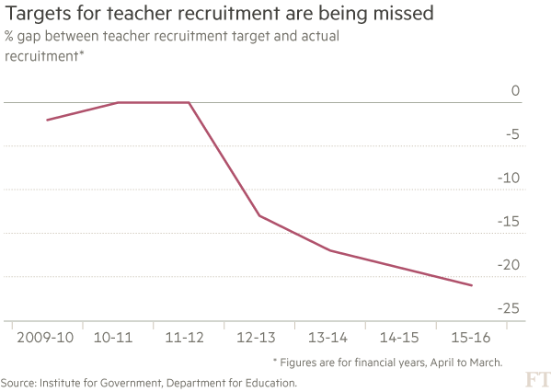
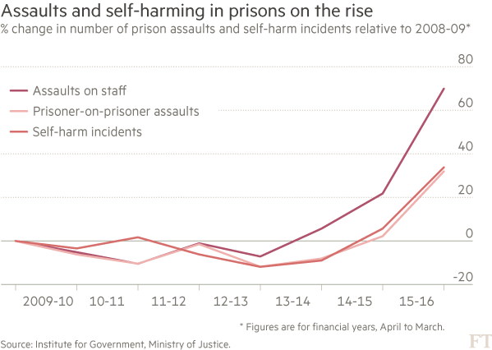
London, April 2017
Multiple government targets are now being missed
Source: Gemma Tetlow, Financial Times, 28th February 2017 (Institute for government)

Slide 23
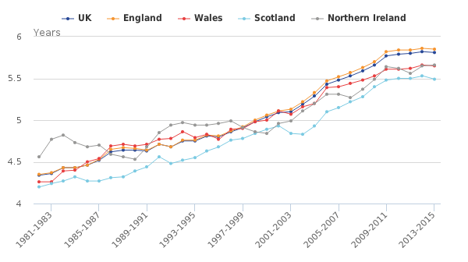
Male life expectancy from age 85
Source: https://www.ons.gov.uk/peoplepopulationandcommunity/birthsdeathsandmarriages/lifeexpectancies/bulletins/nationallifetablesunitedkingdom/20132015

Slide 24
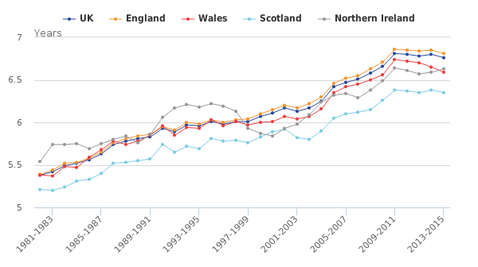
Female life expectancy from age 85
Source: https://www.ons.gov.uk/peoplepopulationandcommunity/birthsdeathsandmarriages/lifeexpectancies/bulletins/nationallifetablesunitedkingdom/20132015

Slide 25
Life expectancy for women in the UK is now lower than in Austria, Belgium, Cyprus, Finland, France, Germany, Greece, Iceland, Ireland, Italy, Liechtenstein, Luxembourg, Malta, the Netherlands, Norway, Portugal, Spain, Sweden, and Switzerland. Men do little better. In almost every other affluent country, apart from the US, people live longer than in the UK, often several years longer and the best countries are pulling away. Between 2011 and 2015 life expectancy rose by a year in both Norway and Finland. It rose by more than a year in Japan, despite the Japanese already having the highest life expectancy in the world.

Slide 26
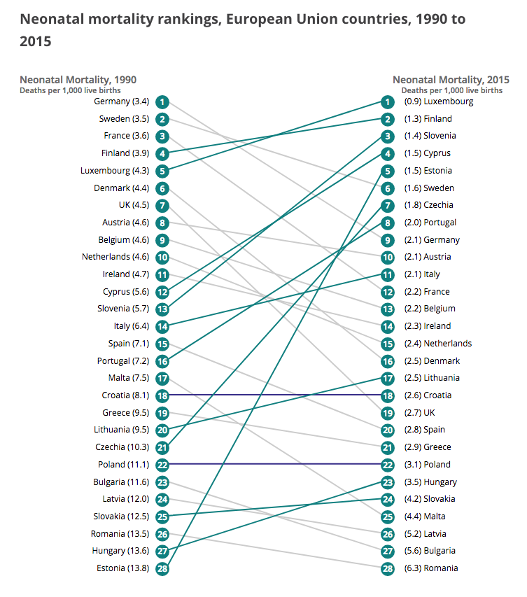
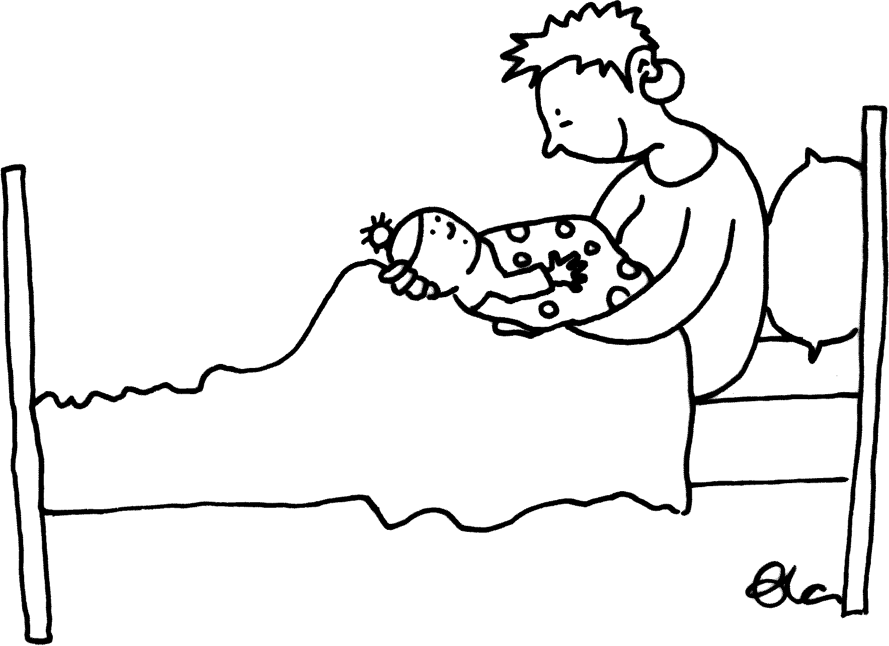
Health effects
https://www.ons.gov.uk/peoplepopulationandcommunity/healthandsocialcare/childhealth/articles/ukdropsineuropeanchildmortalityrankings/2017-10-13

Slide 27
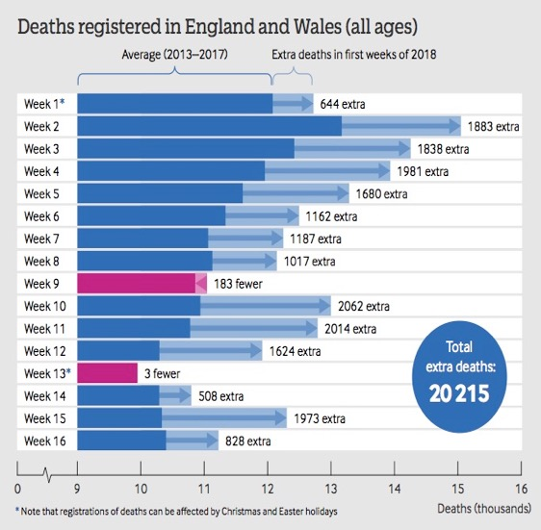

Slide 28
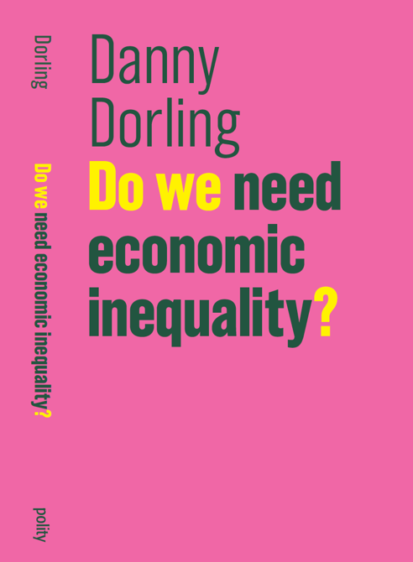
There are long term lag effects (1983 and 2014 here)

Slide 29
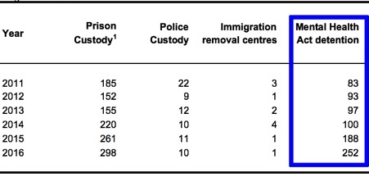
Table 1.1.1: Deaths in State Detention, England and Wales, 2011-2016
Source: Social Care Institute of Excellence, Deprivation of Liberty Safeguards (DoLS) at a glance, June 2017, Table 6 (deaths reported to coroners).
National Statistics, Coroners statistics Annual 2016, England and Wales, 11 May 2017, statistical tables Table 6 (deaths reported to coroners). https://www.gov.uk/government/statistics/coroners-statistics-2016

Slide 30
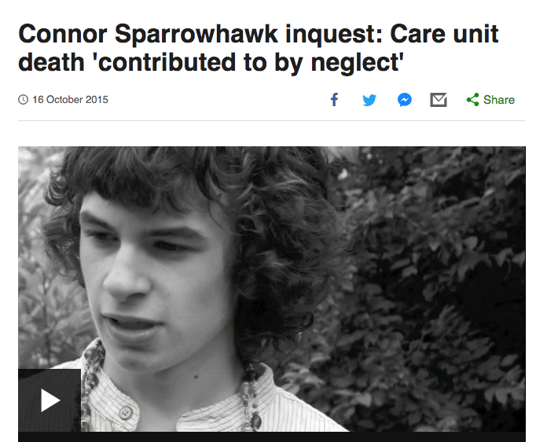
Connor was 18 when he drowned in a bath in Oxford in July 2013 – he had an epileptic seizure at Slade House ‘learning disability unit, run by Southern Health NHS Foundation Trust’
And then you stop looking at so many numbers and consider just one death.
Very near here.
On top of those who die in prison, or detained under the mental health act are many others in care but not being properly cared for.
The Tale of Laughing Boy
https://vimeo.com/130521001

Slide 31
So who should be held to account?
On health:, "health chiefs”, a catch all term for anyone or any group or organization charged with maximizing the health and well being of their population: Department of Health and Social Care.
+ 4 Chief Medical Officers of the United Kingdom
Anyone whose job title is, for example ‘chief knowledge officer’ in an organization should be asked about their contribution to confusion.
In the NHS they have many ‘chief executives', a ‘chief nurse’ and so on: ‘Chief” is the keyword.
Ultimately – Secretary of State for Health and PM. Harold Macmillan escaped proper scrutiny when he blamed the London smog deaths on flu and did little. But we are not in the 1950s anymore.

Slide 32
Lucinda Hiam and Martin McKee: The deepening health crisis in the UK requires society wide, political intervention, March 8, 2019
“These are not just numbers, these are lives”
https://blogs.bmj.com/bmj/2019/03/08/lucinda-hiam-and-martin-mckee-the-deepening-health-crisis-in-the-uk-requires-society-wide-political-intervention/

Slide 33
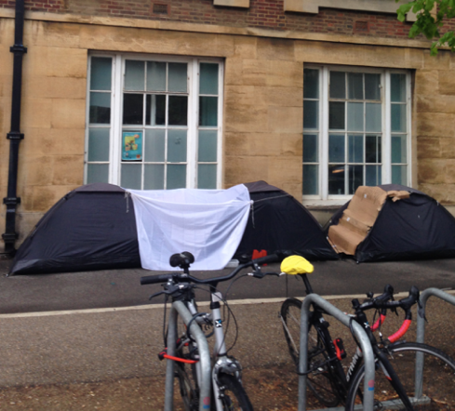
IN A TIME OF AUSTERITY
We remember all who have died while their income was sanctioned, who were overcome by any feelings of humiliation or shame, by fear or distrust, insecurity or loneliness; or by a sense of being trapped and powerless under the abuses of power by the State in a time of austerity.
In a time of austerity we pray, in solidarity with the 1000s of UK citizens currently suffering sanctions, which are imposed with the maximum use of the media to blame decent people for their own unemployment and poverty; for the millions of UK citizens who are suffering under unmanageable debts due to high rents, the council tax, the caps and cuts in social security imposed by Parliament, made worse by sanctions.
We pray too for those in power, and seeking power, that they may find;
The courage to work for and implement social and economic justice,
The will to build a well-being state on the ashes of the welfare state in which rich and poor and Parliament are in solidarity with each other.
The policies to ensure that no one will have to choose between heating or eating, the rent or the streets, life or death due to the unjust enforcement of debts against inadequate incomes, or no incomes at all, due to a sanction.
In the name of Jesus Christ,
Amen

Slide 34
